Slide 1
James 4:1-10

Slide 2
4 What causes quarrels and what causes fights among you? Is it not this, that your passions are at war within you? ² You desire and do not have, so you murder. You covet and cannot obtain, so you fight and quarrel. You do not have, because you do not ask. ³ You ask and do not receive, because you ask wrongly, to spend it on your passions. ⁴ You adulterous people! Do you not know that friendship with the world is enmity with God? Therefore whoever wishes to be a friend of the world makes himself an enemy of God. ⁵ Or do you suppose it is to no purpose that the Scripture says, “He yearns jealously over the spirit that he has made to dwell in us”?

Slide 3
⁶ But he gives more grace. Therefore it says, “God opposes the proud, but gives grace to the humble.” ⁷ Submit yourselves therefore to God. Resist the devil, and he will flee from you. ⁸ Draw near to God, and he will draw near to you. Cleanse your hands, you sinners, and purify your hearts, you double-minded. ⁹ Be wretched and mourn and weep. Let your laughter be turned to mourning and your joy to gloom. ¹⁰ Humble yourselves before the Lord, and he will exalt you.

Slide 4
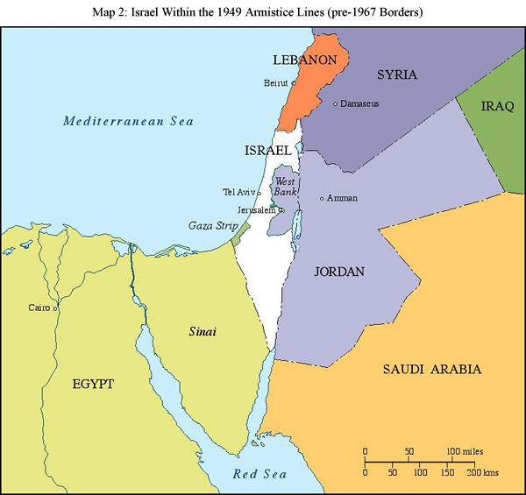
The Middle East 1949-1967

Slide 5
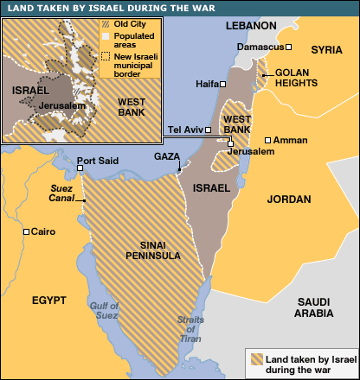
After the Six-Day War
Before the Six-Day War

Slide 6
The War Within
Double-Mindedness: “I want to be a Christian, but a worldly one....”
^{4;1} What causes quarrels and what causes fights among you? Is it not this, that your passions are at war within you? ........
⁴ You adulterous people! Do you not know that friendship with the world is enmity with God? Therefore whoever wishes to be a friend of the world makes himself an enemy of God.
2 combatants – The world, and God
2 different peoples; beliefs; cultures; allegiances; gods (1. Those who are in Christ 2. Those who are in the world)
To be a friend of the world = become an enemy of God
War; Battle; Put to death

Slide 7
The War Within
Double-Mindedness: “I want to be a Christian, but a worldly one....”
2 combatants – The world, and God
2 different peoples; beliefs; cultures; allegiances; gods (1. Those who are in Christ 2. Those who are in the world)
To be a friend of the world = become an enemy of God
War; Battle; Put to death
For a war to lead to lasting peace, there must be:
A decided victor, who rules victorious
A vanquished enemy, expelled; subjugated (totally submitted); put to death
If we allow the old, worldly nature to co-exist with the new, spiritual nature, it will seek to regain rule and power in our lives

Slide 8
The War Within
Double-Mindedness: “I want to be a Christian, but a worldly one....”
2 combatants – The world, and God
2 different peoples; beliefs; cultures; allegiances; gods (1. Those who are in Christ 2. Those who are in the world)
War; Battle; Put to death
For a war to lead to lasting peace, there must be:
A decided victor, who rules victorious
A vanquished enemy, expelled; subjugated (totally submitted); put to death
If we allow the old, worldly nature to co-exist with the new, spiritual nature, it will seek to regain rule and power in our lives
whoever wishes to be a friend of the world makes himself an enemy of God
God opposes the proud, [but] He gives grace to the humble
When we humble ourselves before God, He lifts us up.

